Slide 1

Do more than six stocks matter?
Springboard capstone project report (1/26/2017)
By David Whitney
Mentored by Sameera Poduri

Slide 2
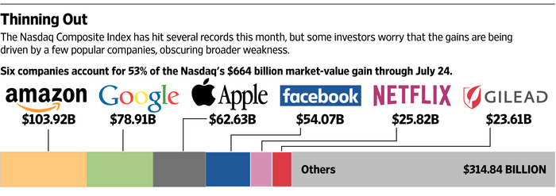
How important are these SIX stocks?
According to a recent Wall-Street Journal article, more than half the value added to the NASDAQ in 2015 came from the “FAANG” stocks alone.
Source: http://www.wsj.com/articles/the-only-six-stocks-that-matter-1437942926

Slide 3
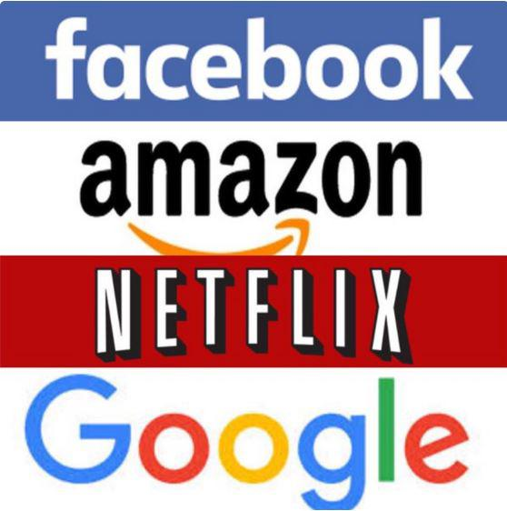
Who are these SIX Stocks?
FAANG stocks are a small group of high performing technology/ pharmaceutical-related companies:
Amazon (AMZN)
Apple (AAPL)
Facebook (FB)
Google (GOOG)
Gilead (GILD)
Netflix (NFLX)
Four companies (Facebook, Amazon, Netflix, and Google) have been affectionately dubbed by Jim Cramer on Mad Money by the acronym ‘FANG.’
So as not to be confusing, the six listed stocks above will be dubbed ‘FAANG’ in this talk.

Slide 4
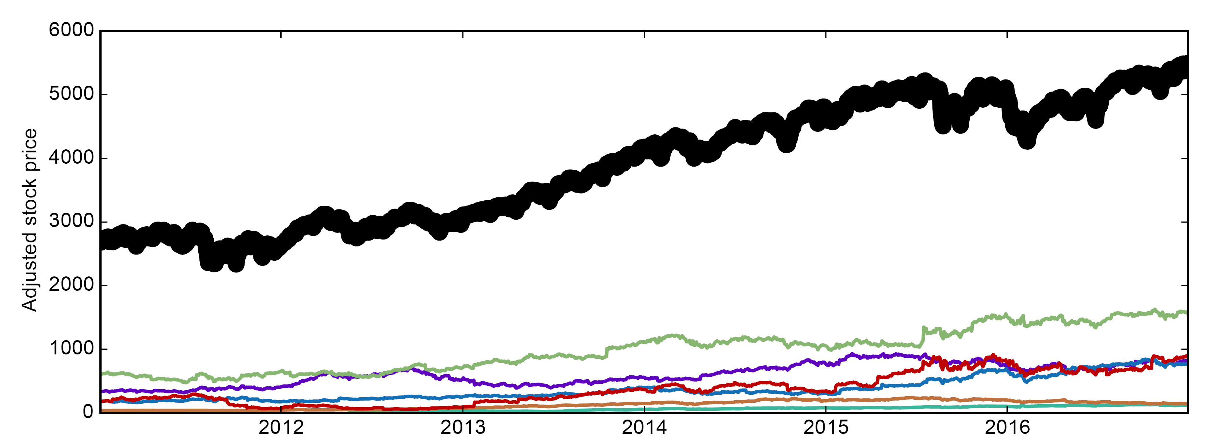
LOPSIDED MARKET RECOVERY BECAUSE OF FAANG?
Recent NASDAQ growth has been heavily dominated by the FAANG stocks
Is market growth primarily concentrated in a few winners or reflects a broader market recovery?
Let’s look at this using historical stock data from Yahoo finance!
Perhaps providing some evidence for the first viewpoint, FAANG stocks have closely tracked with NASDAQ over the last six years:
NASDAQ
APPL
AMZN
FB
GOOG
GILD
NFLX
Note: Each stock trace has been z-scored allowing relative growth to be compared

Slide 5
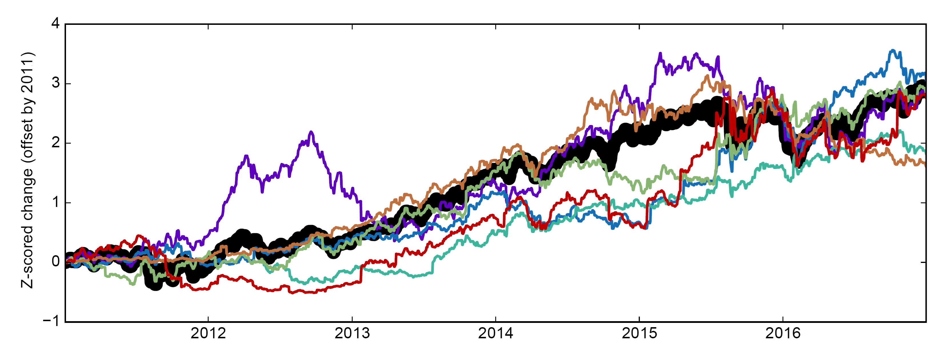
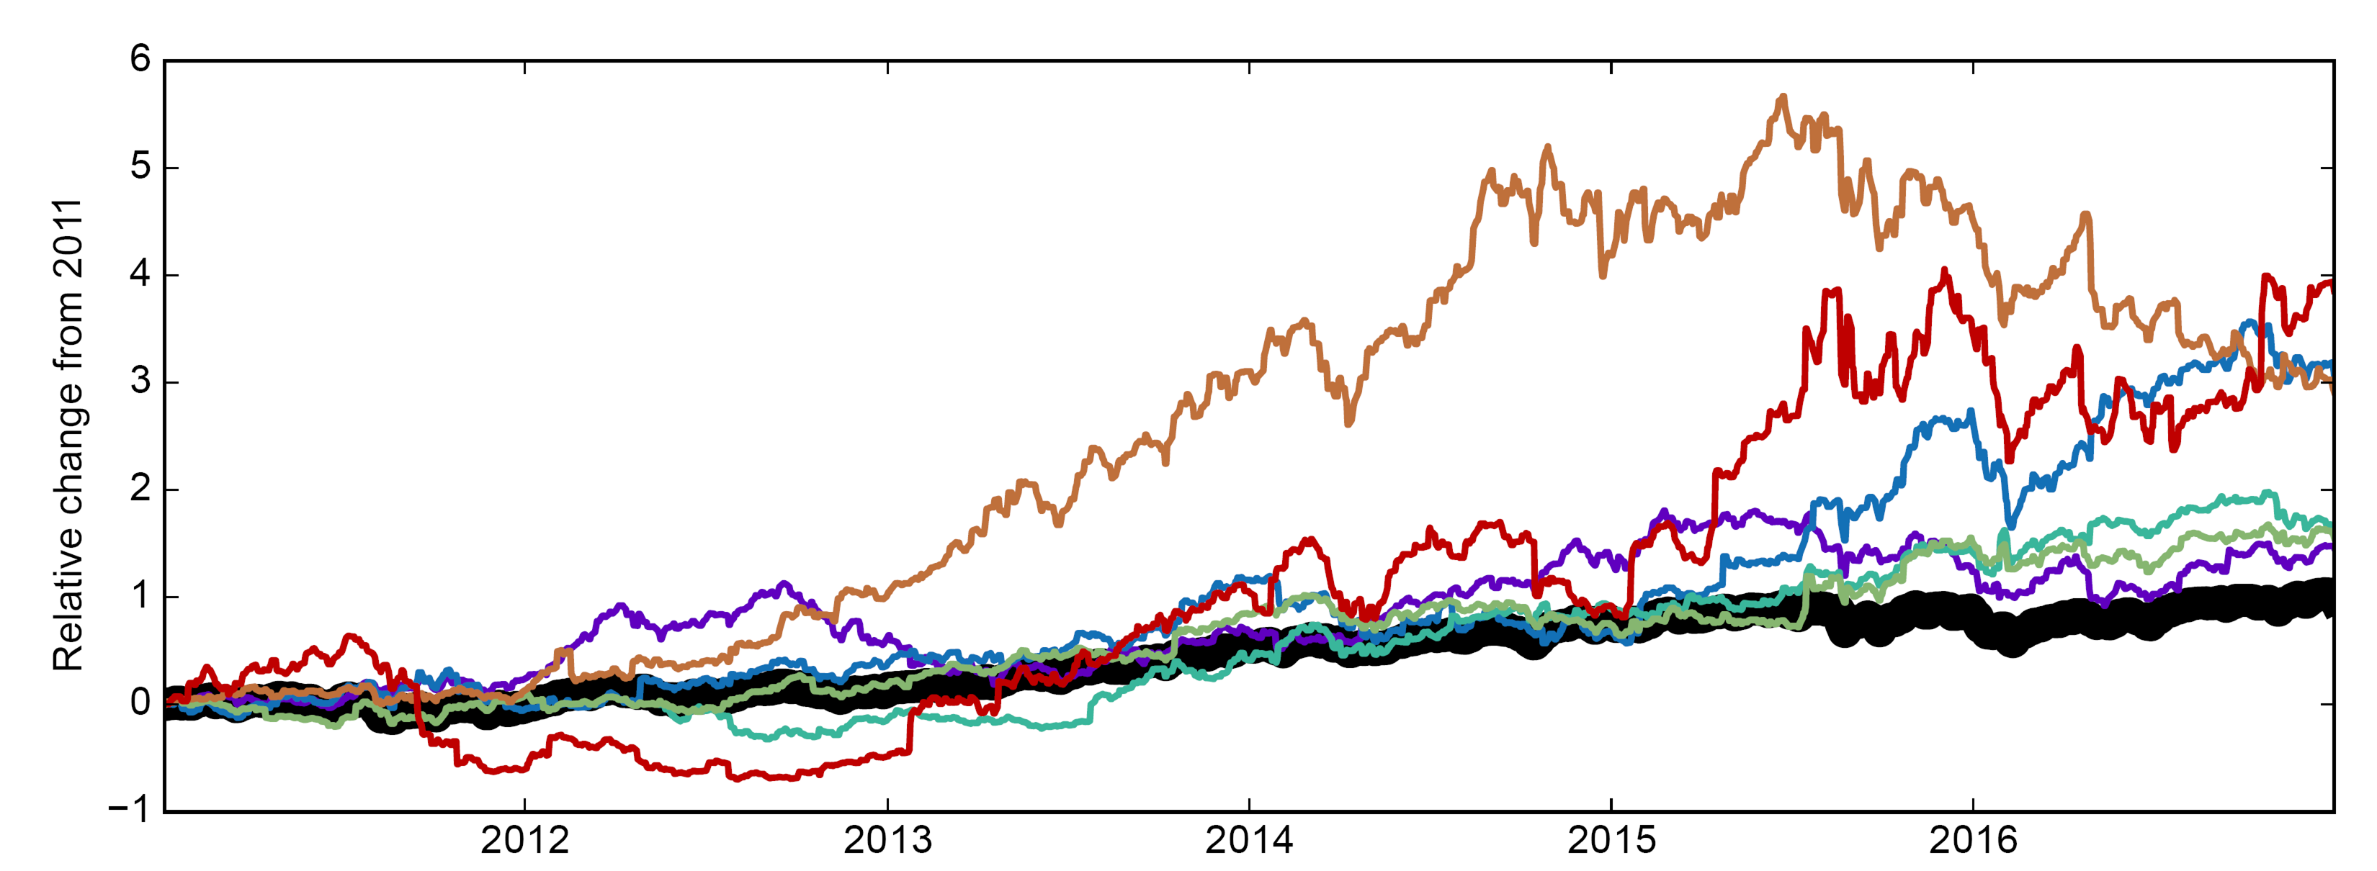
LOPSIDED MARKET RECOVERY BECAUSE OF FAANG?
Recent NASDAQ growth has been heavily dominated by the FAANG stocks
Is market growth primarily concentrated in a few winners or reflects a broader market recovery?
Let’s look at this using historical stock data from Yahoo finance!
Perhaps providing some evidence for the first viewpoint, FAANG stocks have closely tracked with NASDAQ over the last six years:
NASDAQ
APPL
AMZN
FB
GOOG
GILD
NFLX
Note: Each stock trace has been z-scored allowing relative growth to be compared

Slide 6
LOPSIDED MARKET RECOVERY BECAUSE OF FAANG?
Recent NASDAQ growth has been heavily dominated by the FAANG stocks
Is market growth primarily concentrated in a few winners or reflects a broader market recovery?
Let’s look at this using historical stock data from Yahoo finance!
Perhaps providing some evidence for the first viewpoint, FAANG stocks have closely tracked with NASDAQ over the last six years:
NASDAQ
APPL
AMZN
FB
GOOG
GILD
NFLX
Note: Each stock trace has been z-scored allowing relative growth to be compared

Slide 7
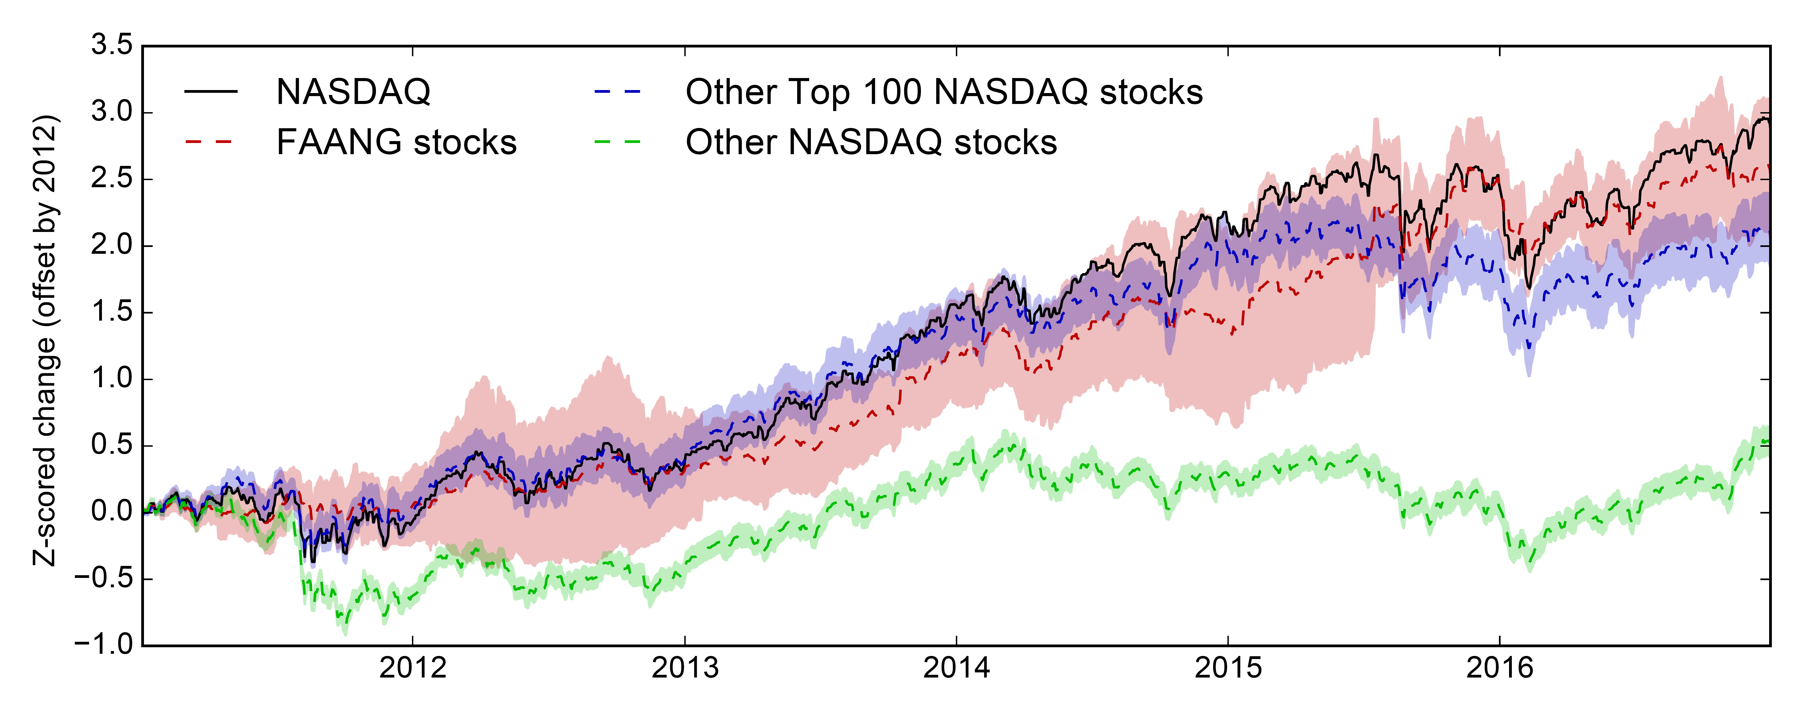
BUT IT’S NOT JUST THE FAANG STOCKS THAT HAVE GROWN
For the last five years, other leading NASDAQ stocks included in the Top 100 NASDAQ list (excluding the FAANG stocks) have mostly tracked with the NASDAQ + FAANG stocks!
Unfortunately this was not the case for most NASDAQ stocks…
Instead the larger bulk of NASDAQ stocks have collectively stagnated.
Even Top 100 stocks have mostly plateaued since 2015
Lines: Group averages
Shading: 95th confidence intervals

Slide 8
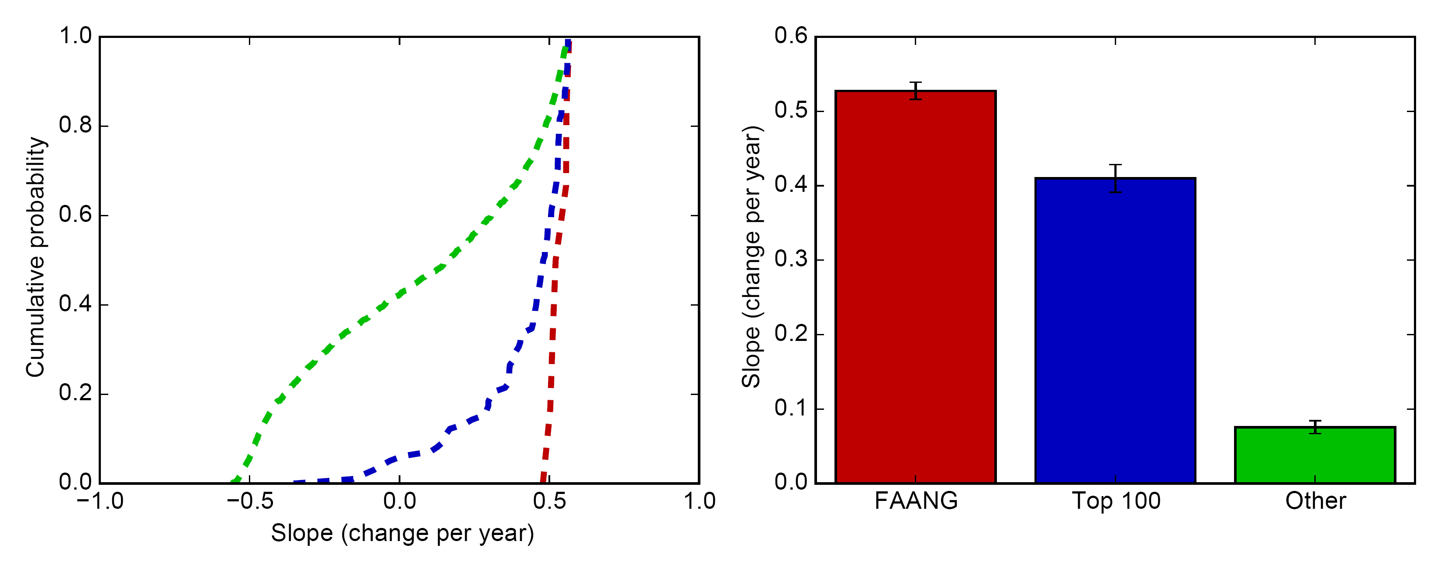
BUT MORE THAN THE 100 NASDAQ stocks ARE GROWING
A closer look reveals that ~60% of Top 100 NASDAQ and ~20% of regular NASDAQ stocks show comparable growth rates to FAANG stocks.
Growth computed as the slope of the z-scored historical stock traces
On average, the relative growth of the FAANG and Top 100 is similar
FAANG
TOP 100
OTHER

Slide 9
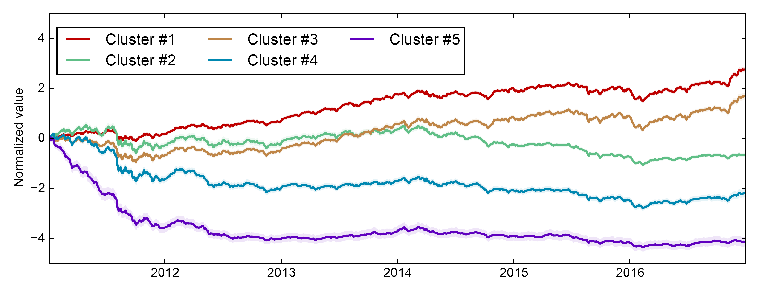
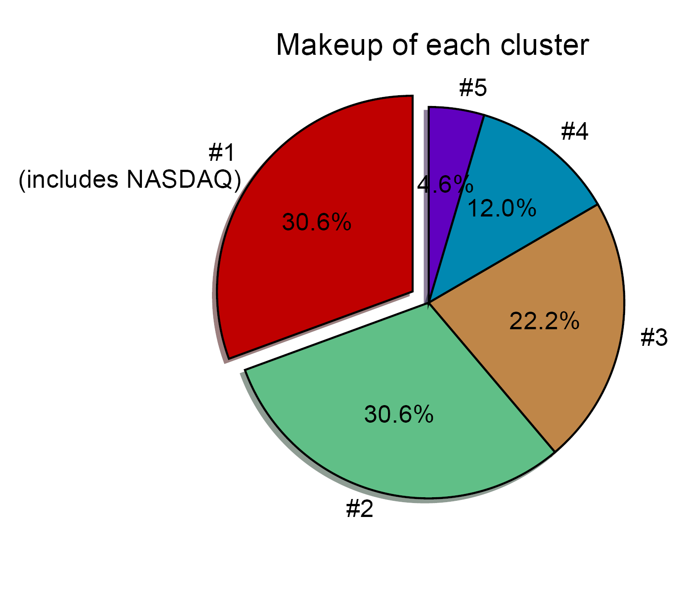
Clustering ANALYSIS TO REVEAL GENERAL TRENDS
Using K-Means clustering, we can divide the 3000+ NASDAQ companies into five different clusters revealing general trends across stocks:
A major defining event was the August 2011 stock market fall due to the European sovereign debt crisis and a downgrading of the U.S. credit rating.
Afterwards ~30-50% of stocks started to grow again.
Cluster #1 and a bit from Cluster #3
But other stocks mostly stagnated.

Slide 10
Some THINGS TO CONSIDER
Before moving on, I want to briefly note some important, and possibly controversial, decisions I made on the analysis.
Considerations:
Not including all NASDAQ stocks: Although 3,000+ companies makeup the NASDAQ, not analyze every company. Instead I only considered stocks that had been traded on NASDAQ for at least one full calendar year (252 trading days).
This parameter was varied from two other extremes:
Include all stocks, regardless of how long they’ve been listed
Include only stocks that were presented for the entire year (means FB was dropped)
The results were robust across all parameters

Slide 11
Some THINGS TO CONSIDER
Before moving on, I want to briefly note some important, and possibly controversial, decisions I made on the analysis.
Considerations:
Not including all NASDAQ stocks: Although 3,179 companies current make of the NASDAQ, I did not analyze every company. Instead I only considered stocks that had been traded on NASDAQ for at least one full calendar year (252 trading days).
Normalizing the data by a z-score:
A percent change is a better measure for the absolute growth of a company
However, z-scoring:
Affords us the opportunity to look at the general shape/trend of growth
Gives each company an equal “vote” to the group average.

Slide 12
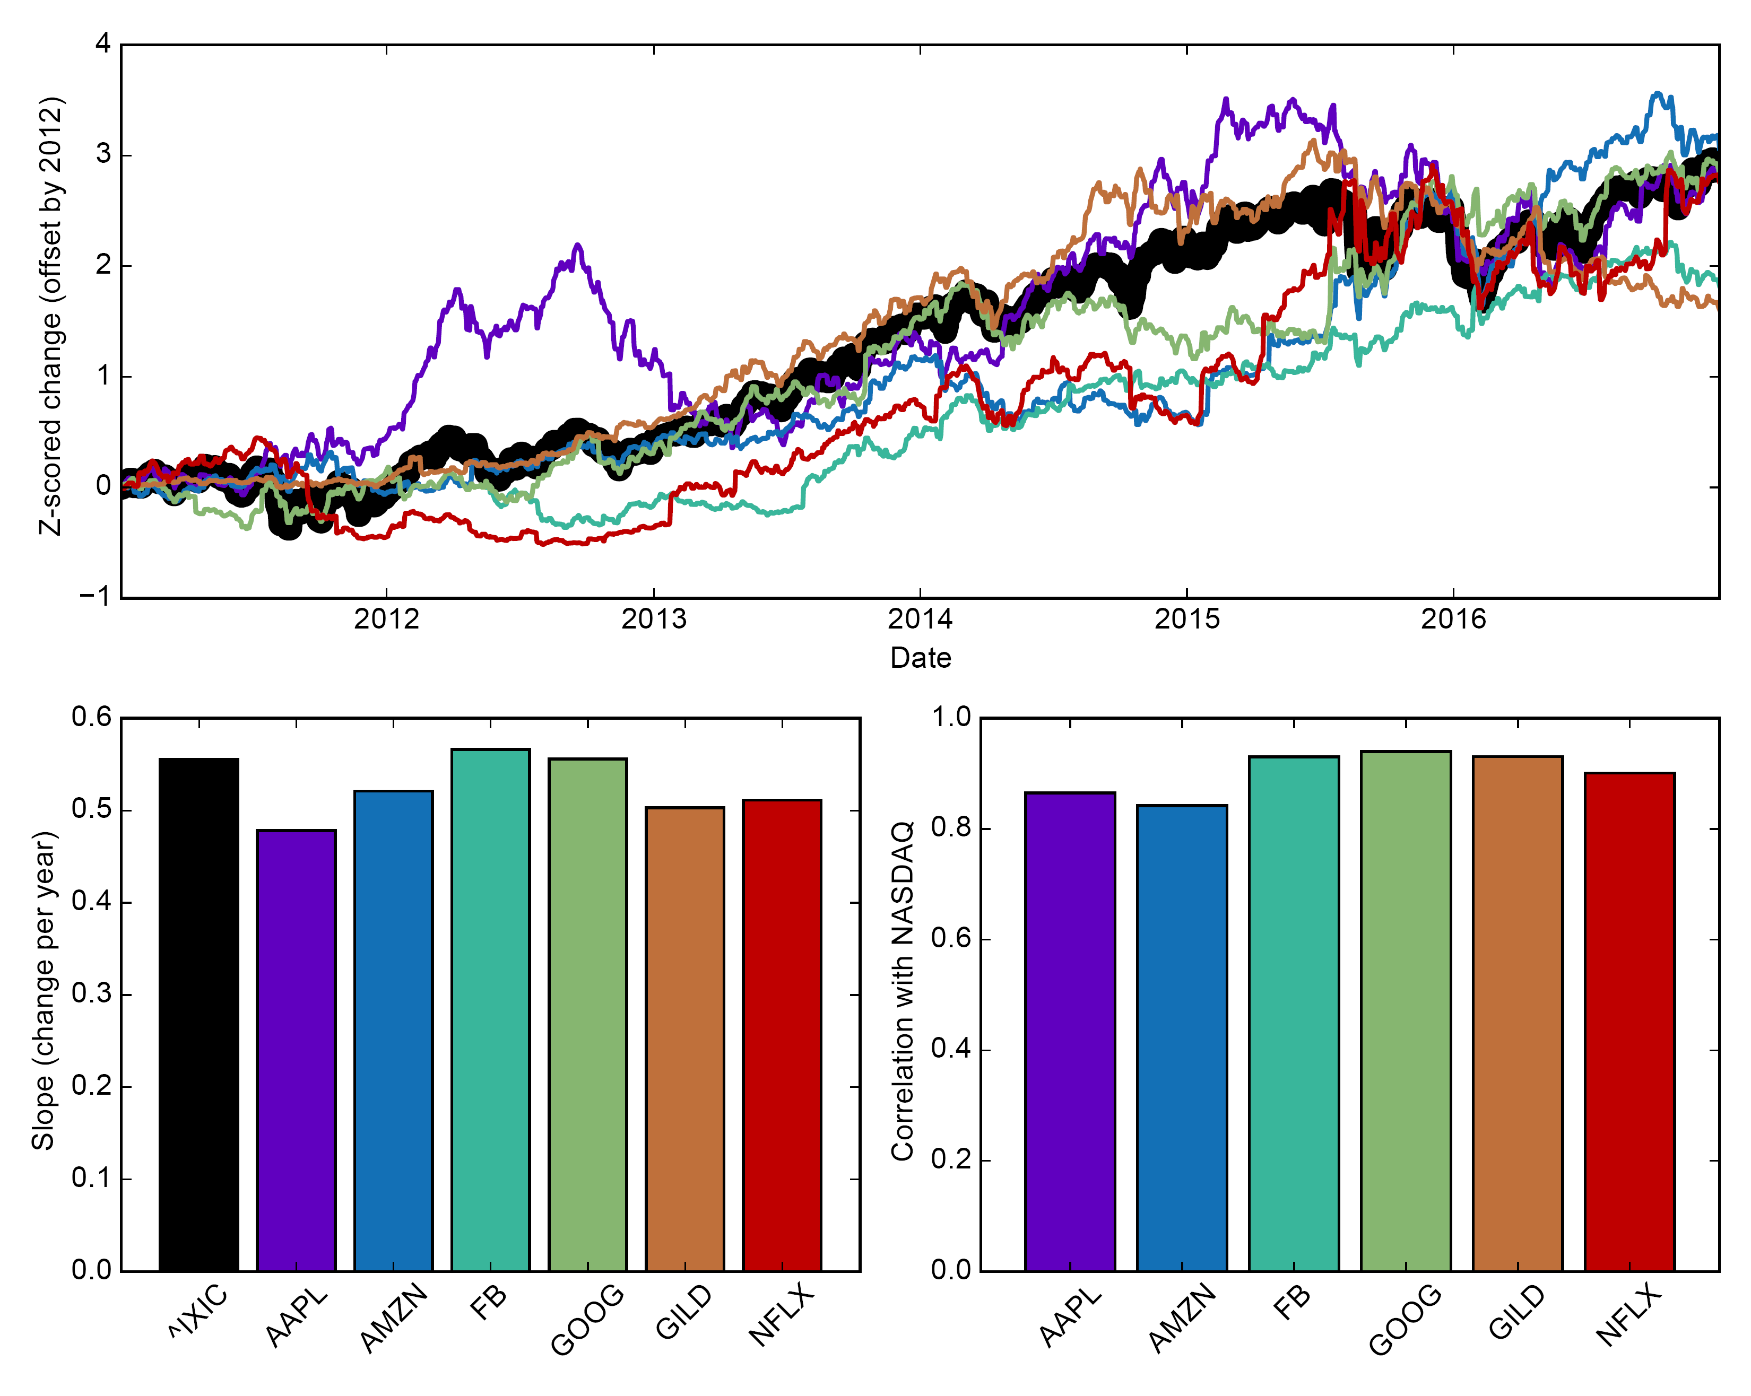
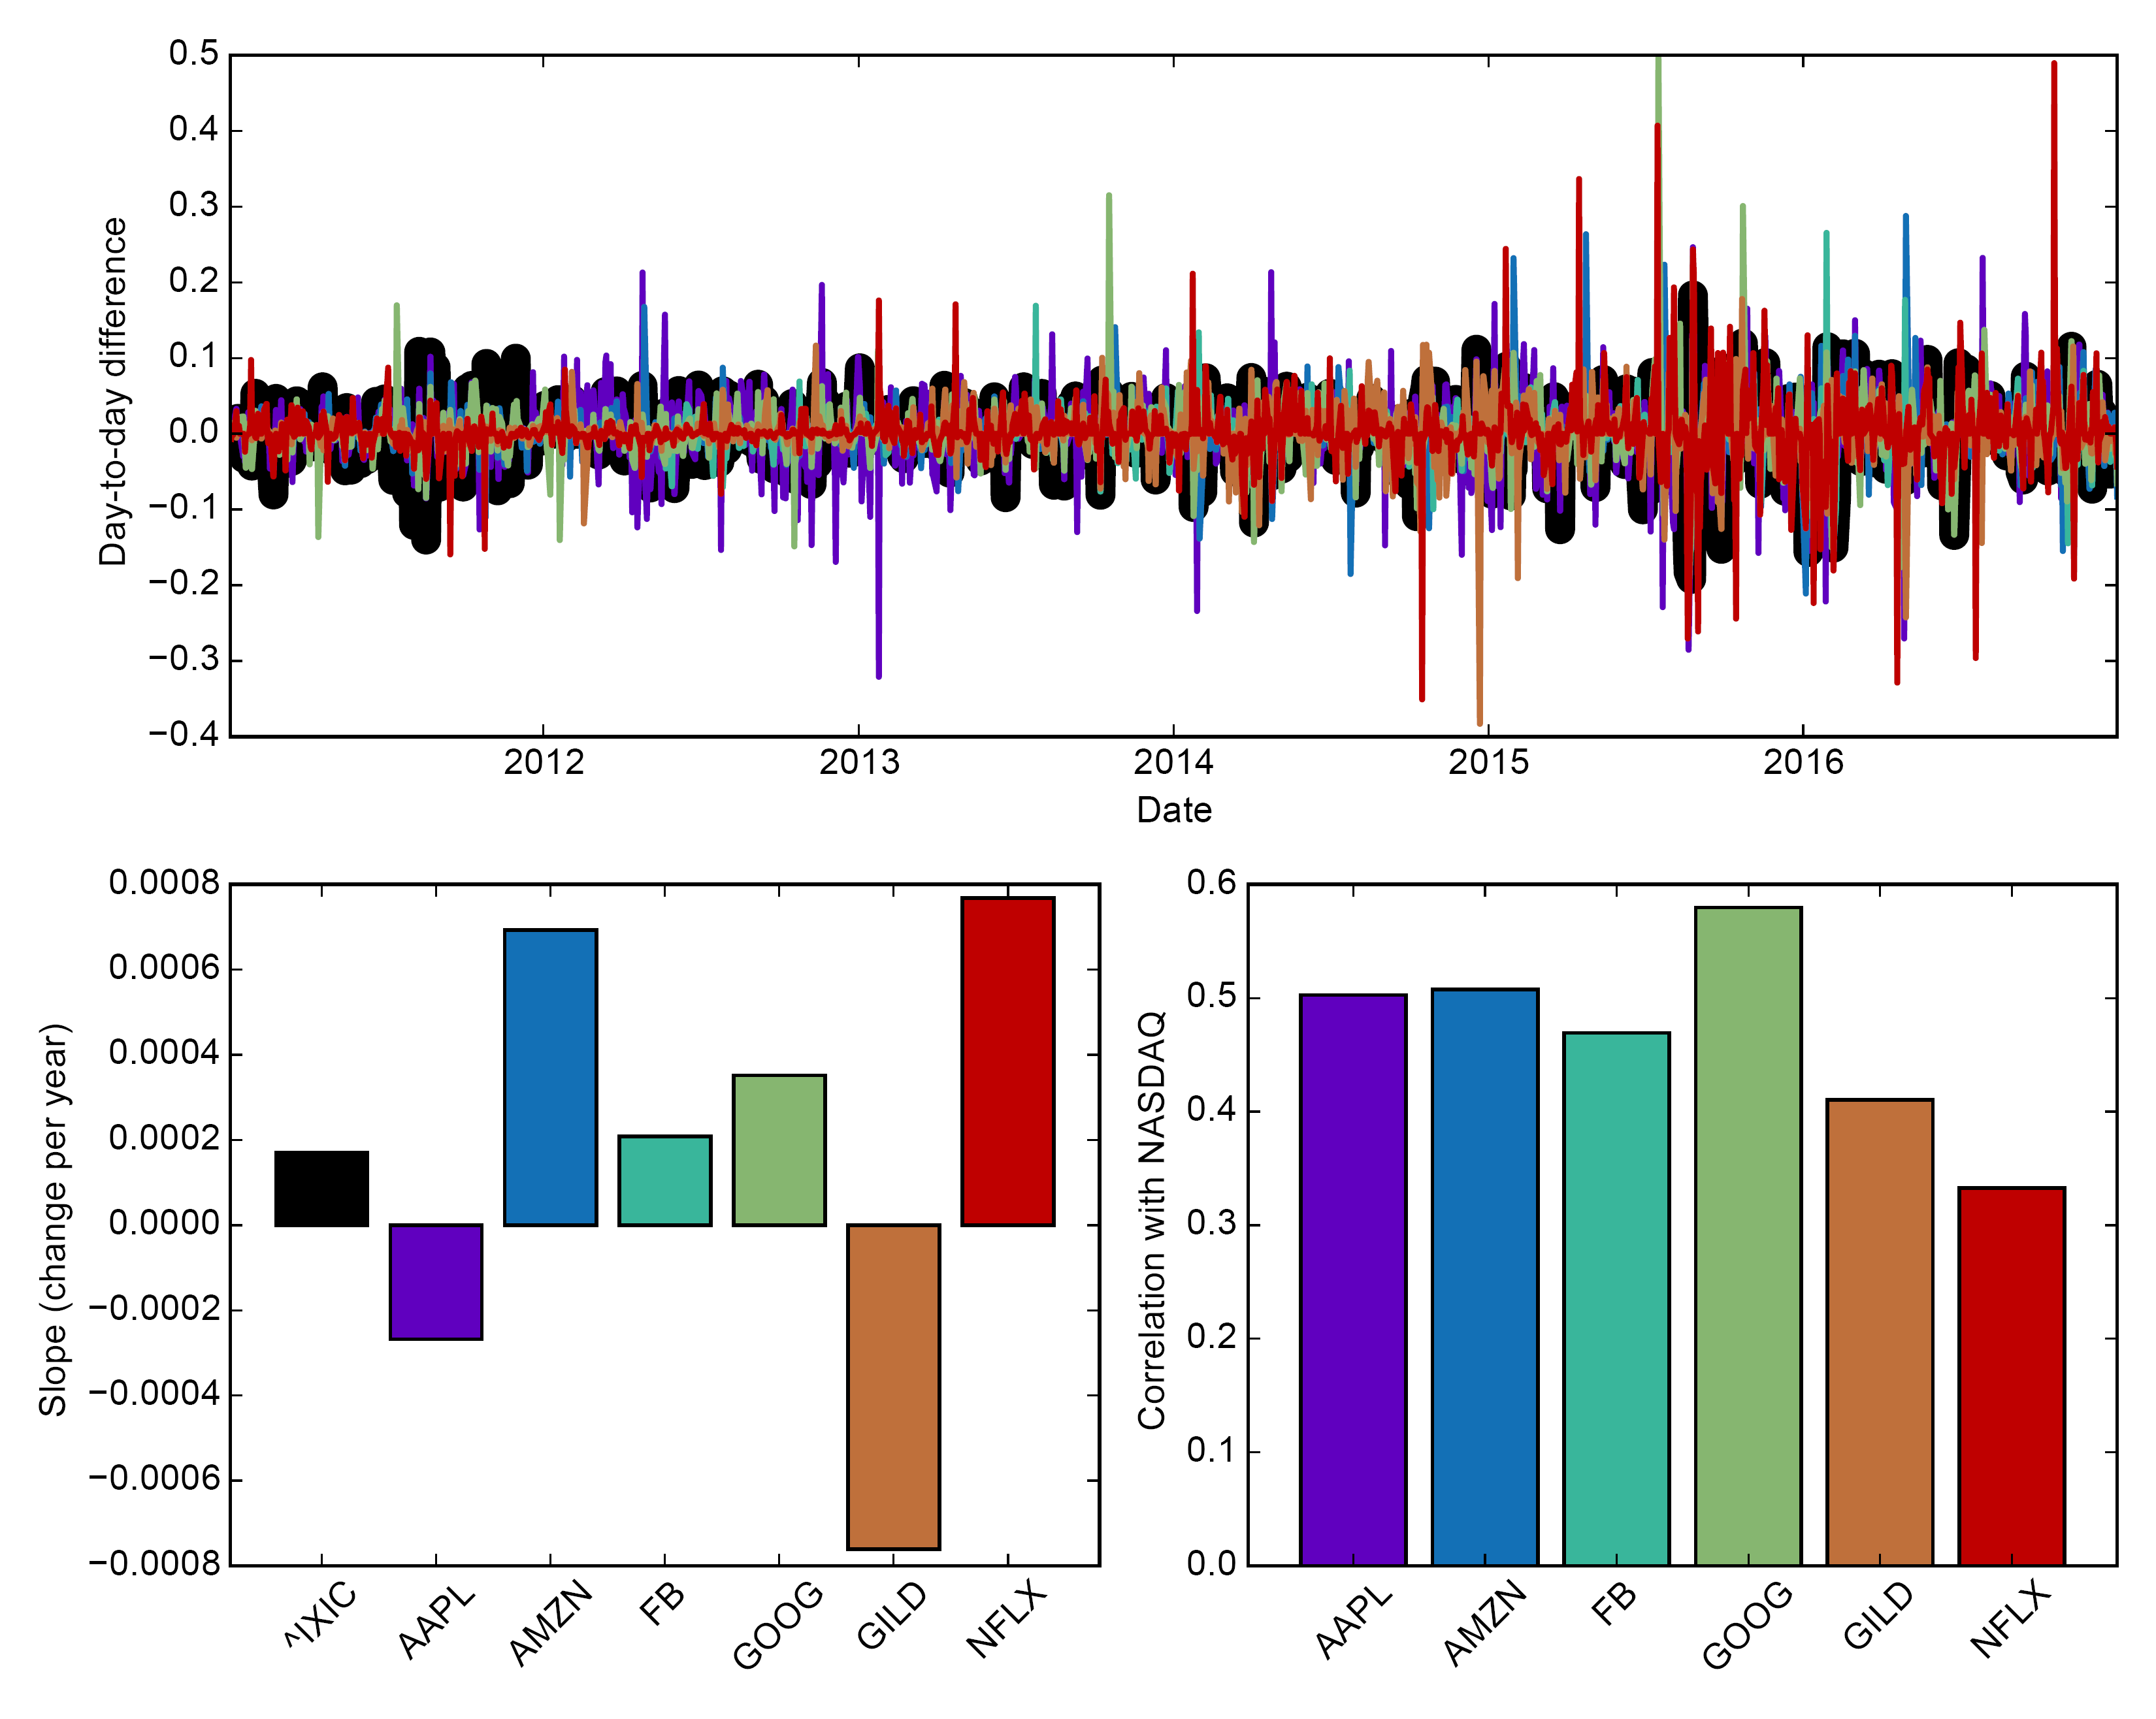
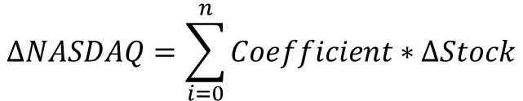
COULD The TOP STOCKS DRIVE NASDAQ GROWTH?
Let’s try regression:
While regression is not perfect, we can learn whether certain stocks are more likely than others to explain market swings.
For the analysis, we’ll look at day-to-day changes in z-scored stock price, and then relate these fluctuations back to changes in the NASDAQ index:
$$ΔNASDAQ=\sum_{i=0}^{n}{Coefficient∗ΔStock}$$
NASDAQ
APPL
AMZN
FB
GOOG
GILD
NFLX

Slide 13
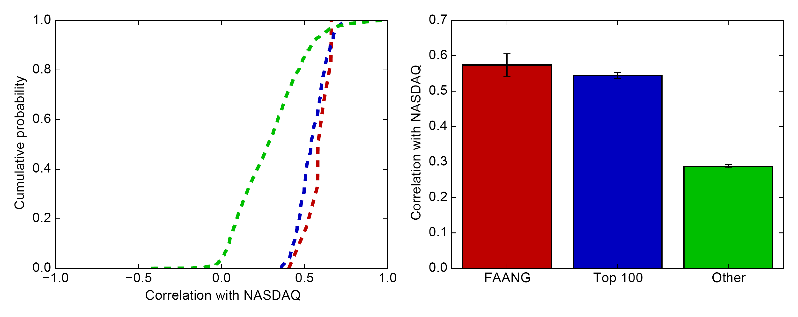
What Makes US THINK WE CAN DO THIS?
Day-to-do fluctuations in stocks are often positively correlated with market movements.
Correlations between the NASDAQ and each stock are computed for the last 24 quarters (2011-2016), and the average is shown below:

Slide 14
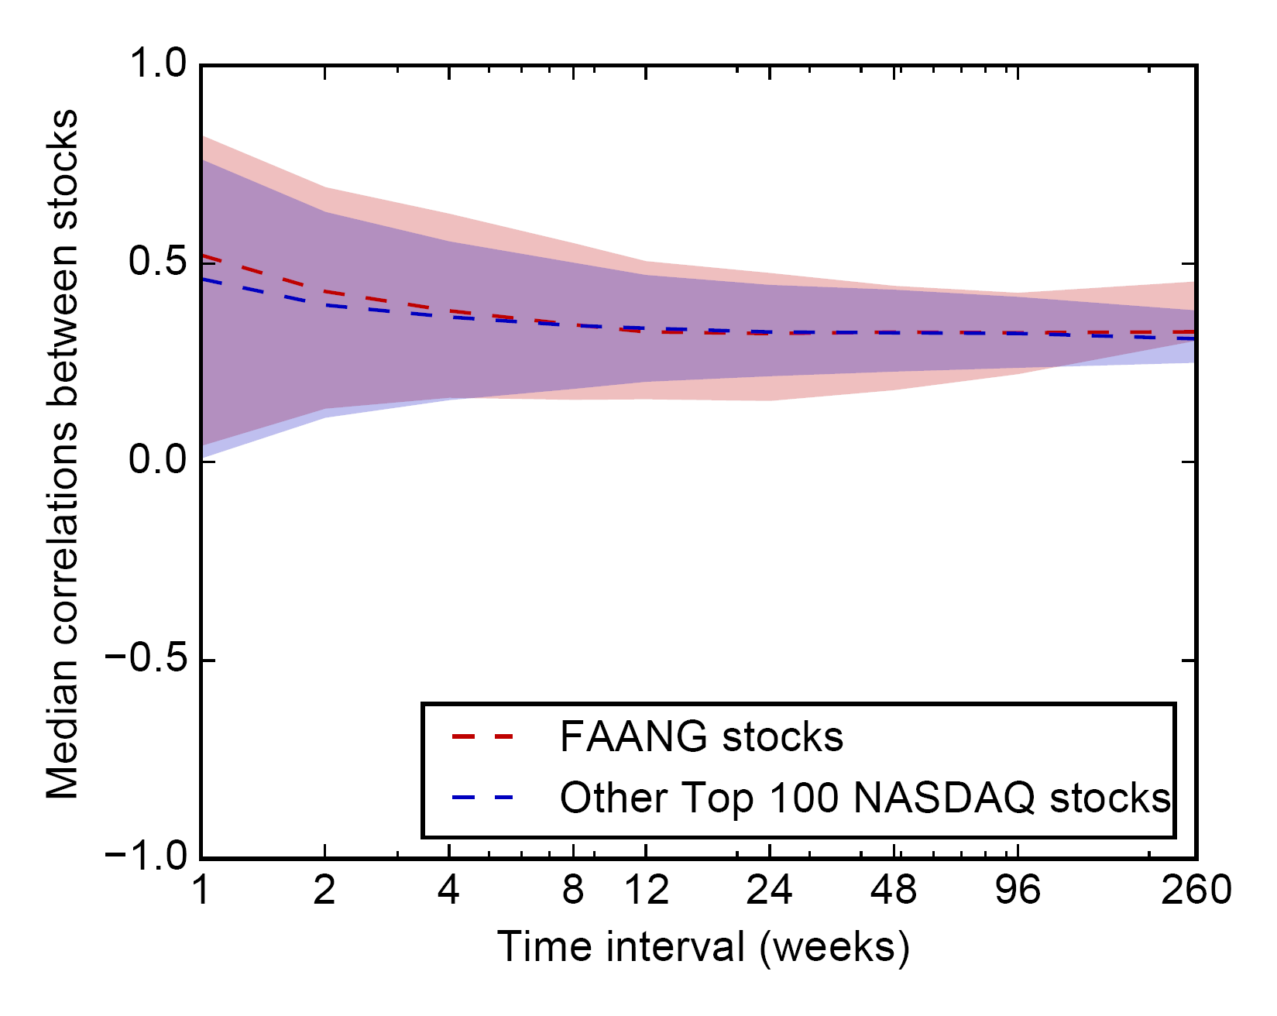
THE PROBLEM OF Multicollinearity
BUT there’s a problem with this analysis…
Many of our stocks (i.e. features) are often highly correlated, and this is problematic for regression, especially on short-time scales:

Slide 15
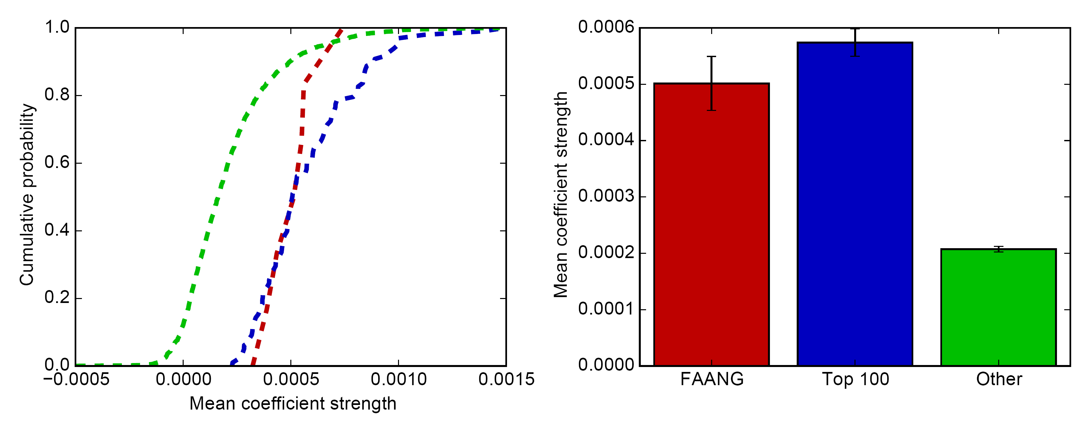
Ridge Regression (Regularization WITH l2-Norm)
To deal head-on with the issue of multi-collinearity, I chose to employ Ridge Regression with cross-validation and then compute the relationship progressively on quarterly data.
I am presenting below the average across all 24 fits:

Slide 16
CONCLUSIONS
While FAANG stocks have grown substantially, and closely co-vary with the NASDAQ, these stocks do not behave fundamentally different than many other NASDAQ stocks.
In fact, nearly 20% of NASDAQ stocks display similar growth rates to FAANG stocks
This group of stocks includes most Top 100 NASDAQ stocks.
Thus, there are many other growing companies that warrant a look by investors!
Furthermore, while capital might be heavily concentrated in the FAANG stocks, consistent growth in ~20% of NASDAQ stocks is an encouraging sign that the market recovery has not been purely driven by a handful of stocks.

